Slide 1

Education 3.0 for
Transforming Teaching & Learning: a Flipped Learning Experience at KAIST
East-Asia Research Universities
Teaching and Learning Symposium at Nanjing University
May 21, 2014
Professor Tae-Eog Lee
telee@kaist.ac.kr
Director
Center for Excellence in Learning & Teaching

Slide 2
What are the most important inventions in education?

Slide 3

Blackboard
11th Century in India
18th Century in Europe
1801 in USA

Slide 4
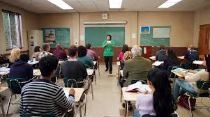
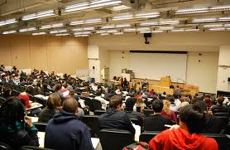
Classroom

Slide 5
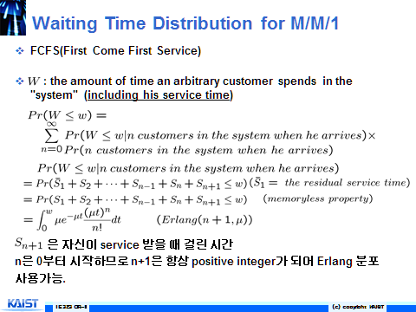


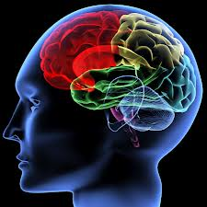
PowerPoint
Efficient for Delivering Much Information
Ideal for Mass Education & Lecturing
Overhead Projector
Cognitive
Overload

Slide 6
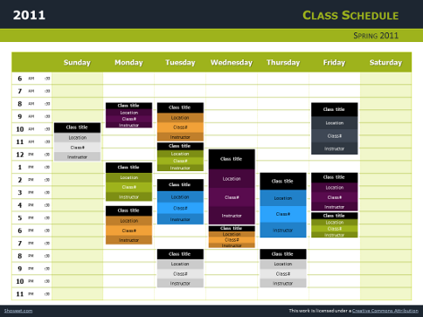
Class Hours/Schedules
School System
50 min class,
10 min break,
weekly schedule,
semester,
elementary/middle/
high,
…

Slide 7
All they are for ???
Mass Education
Educate nation
cf. Mass Production
Lecturing,
Standardization

Slide 8
Who initiated
Mass Education
Prussia
19th

Slide 9

Quality

Slide 10
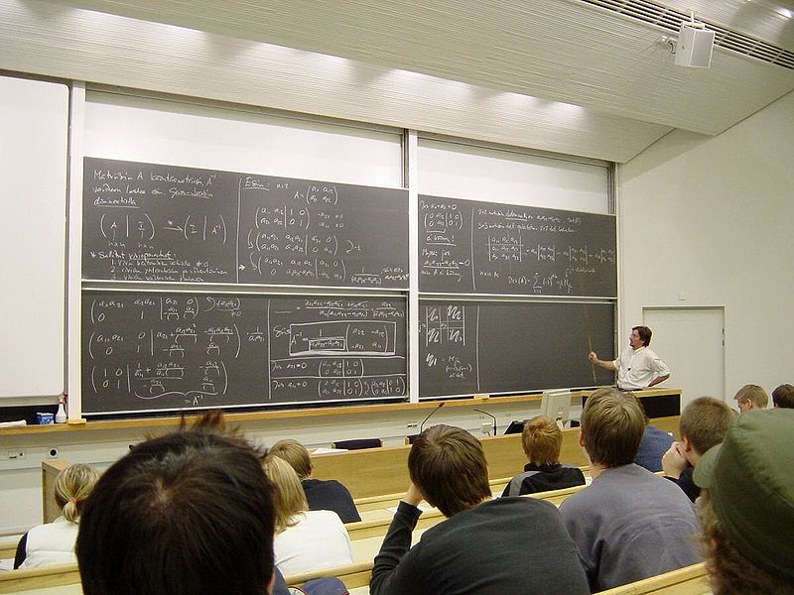
Lecturing
One-Way Information Transfer
Limited Interaction
Passive
Lecturer-Centric
Vertical

Slide 11
What are the most helpful for your study?
A survey for students in a “tutoring” class for a basic compulsory course (lecturing)
  Nov. 9, 2012, KAIST
Solving Quizzes
Textbooks
Group Study
Lecturing
10%
Books in Korean
Tutoring
Recitation
Others

Slide 12

Failed Mission of Education?
  Harvard Conference on Teaching & Learning, Feb. 2012
  Failed mission of understanding genuine meaning of the learned, making questions, deriving knowledge, and applying it and creating new ones in a new context
Harvard Univ.: Donation of $40 million for teaching and learning innovation by Gustave M. and Rita E. Hauser
Teaching & learning innovation methods
Classroom Innovation

Slide 13

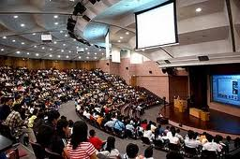
‘LectureFail’ Project
Chronicle of Higher Education
http://chronicle.com/article/Lecture-Fail/130085/
Debate on College Teaching at YouTube
Students
Professors
PowerPoint Abuse

Slide 14


Another Invention?
e-Learning
MOOC
(Massive Open Online Course)

Slide 15
All they are for ???
“Lecturing”

Slide 16
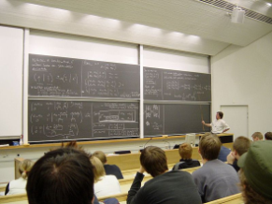
Teaching
Learning
?
?
?
Lecturing

Slide 17
Active
Learning
Problem-Based
Learning
Outcome-Based
Education
Blended
Learning
Flipped/
Inverted
Learning
e-Learning
Personalized
Learning
Collaborative
Learning
17

Slide 18
Why not so successful for replacing or improving lecturing?
Because most class hours are consumed for lecturing.
Lecturing is the most convenient for professors.
PowerPoint is too Powerful! …

Slide 19
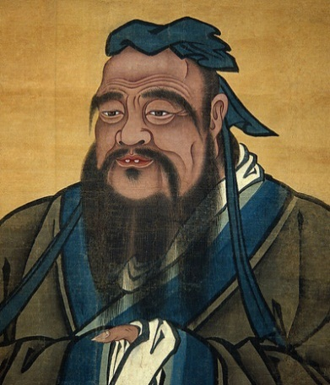
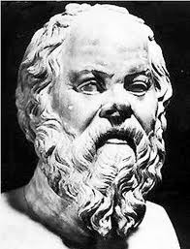
Communication
Interaction
Q&A, Discussion
Self-Learning
孔子
Confucius
Socrates
All Lost, Lecturing for Mass Education
19

Slide 20

Simple,
Effective

Slide 21
Don’t Lecture
in a “class”
Send lecturing
to Internet!

Slide 22
What
in a class?
Anything
but lecturing!

Slide 23
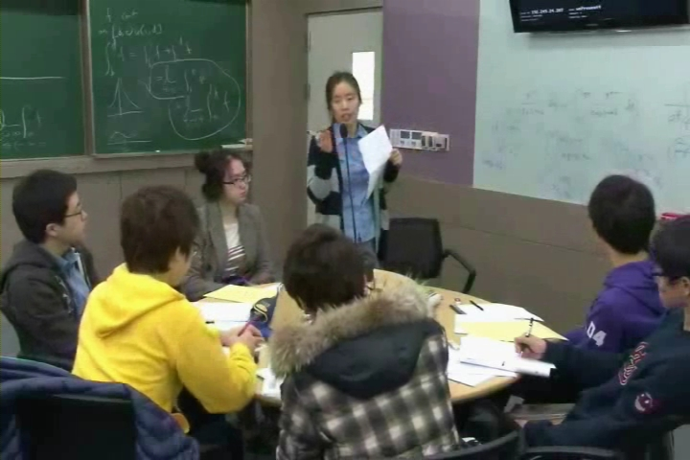
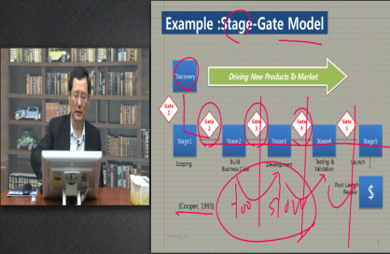
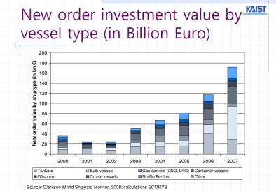
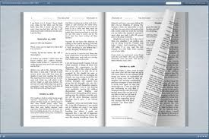
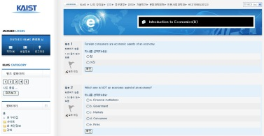
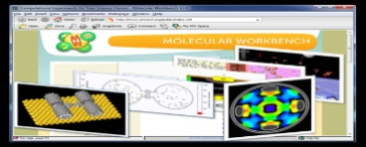
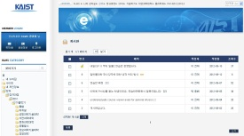
Education 3.0 Class Model
Interactive Class
Online Self-Learning
Lecture Video
Lecture Slides
No Lecturing
Flipped
Textbook
Quiz & HW
Q&A,
Information Sharing,
Social Network Services
Virtual Lab
Problem-Based, Collaborative, Active
Interaction in Class
Online Interaction
Q&A
Discussion
Team Learning/Task
Interactive
Exercise
Evaluation
Presentation
Labs
QuierySearch
Interactive Watching
Q&A
Inform.Sharing
Discussion
Authentification
Evaluation
Team Learning + TA Support

Slide 24
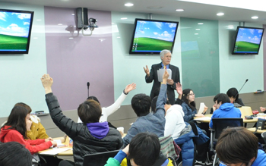
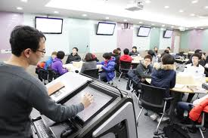
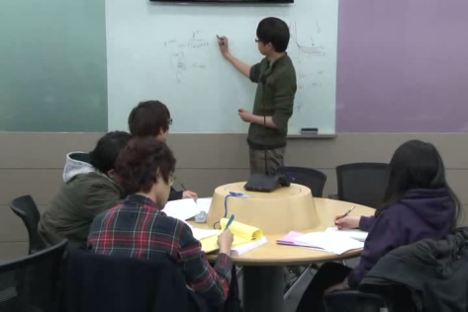
Interactive Teaching & Learning in Class
Quizzes
Q&A
Review & Summary
Interactive Problem Solving
Discussion
Group Learning/Discussion/Project
Labs

Slide 25
Changes for Interaction
Assume self-study of lecture videos, quizzes, & problem sets before coming to the class
Max 48 Students/Class – 2 Sessions for 100 Students
½ Class Hours: One Class/Week
6 Students/Group
1 TA for each 15 students: 2~4 TAs/Class
More TA roles in classrooms
Individual professor consulting
New Interactive Classrooms

Slide 26
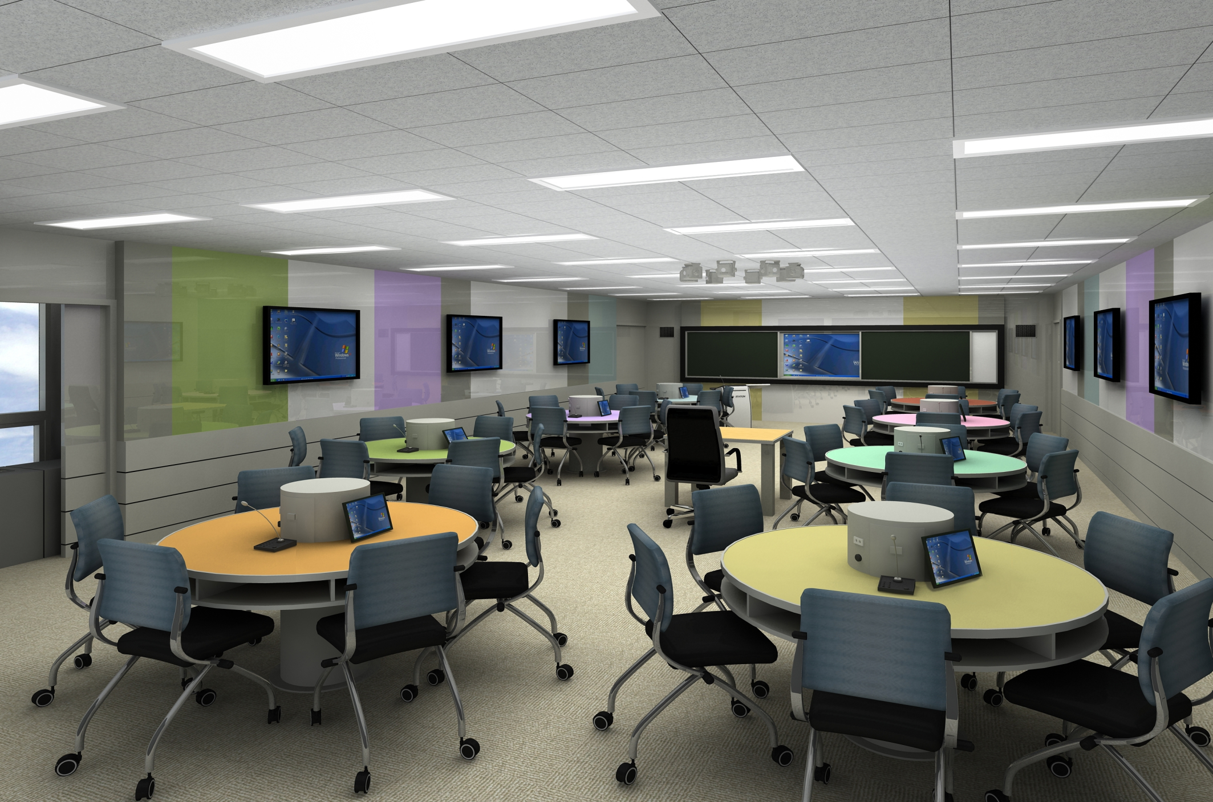

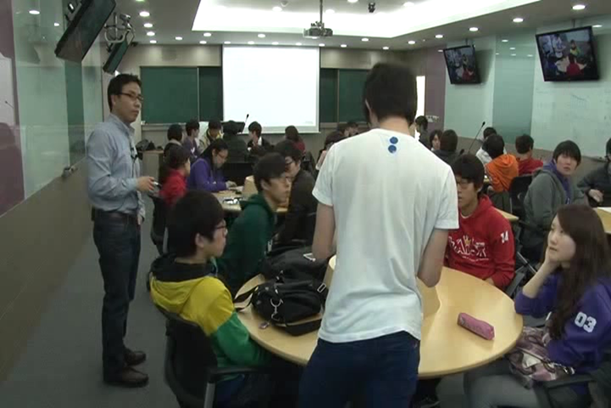
Interactive Classrooms
4 Classrooms in Spring 2013 ➔ 8 More in 2013

Slide 27
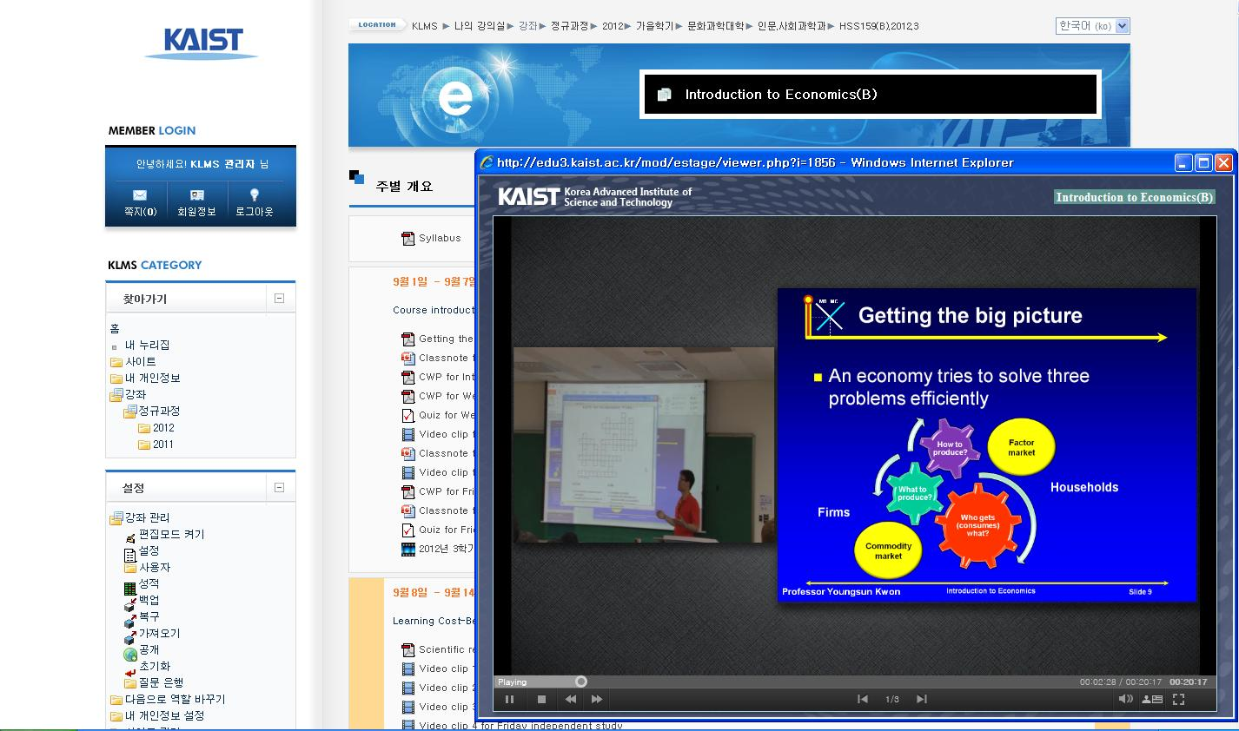

Online Self-Learning System: e-Learning
Personalized,
Interactive,
Intelligent,
Collaborative
MOODLE-based, CAMTASIA,
Segmented into 10 min,
Q&A, Quizzes, SNS,
Smartphone Camera-based Q&A, Concept Tree, …
e-Learning Technologies – available, evolving
27

Slide 28

Effectiveness?
Justified?

Slide 29
Overall Satisfaction
Spring 2012
Pilots for Freshmen
Calculus I
General Chemistry I
Design &
Communication

Slide 30
Overall Satisfaction: 4.1
Fall 2012
Overall Satisfaction
Compulsory Basic
Major Selectives
10 classes

Slide 31
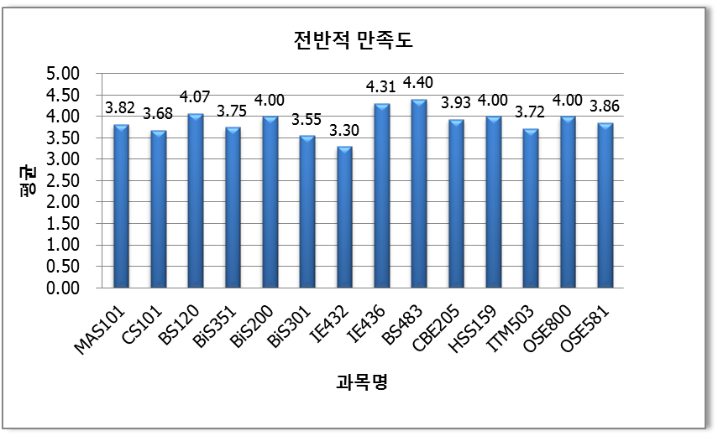
Overall Satisfaction: 3.9
Spring 2013
Total 18 courses, Survey responses for 14 courses
Some courses still made lecturing ➔ Low satisfaction

Slide 32
Student Feedback (2013)
64 classes
Overall satisfaction: 3.9/5.0
Retention: 65~69% (Neutral 24%)
Better than Lecturing: 65~69% (Neutral 28%)
Learning Habit Change: 71%
Expansion

Slide 33
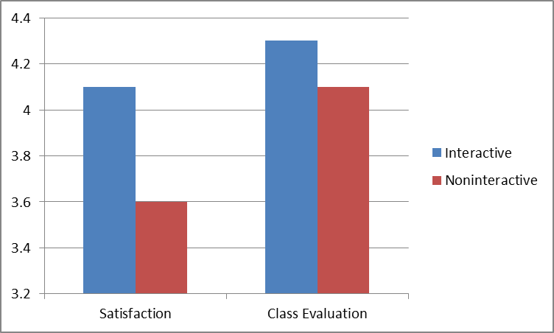
Interactive vs. Noninteractive Class
Fall 2013
Interactive > Average Interaction Level
Nonineractive < Average Interaction Level
64 classes in 2013
Interaction is effective.
5-point
scale
0.2
0.5

Slide 34
Better Exam Scores
Introduction to Computer Programming
  Mid & Final Exams: 3rd of 12 classes (fall 2012)
  1st of 11 classes (fall 2013)
Calculus II
  Mid Term Exam: 10 points higher than average of other 9 classes (fall 2012)

Slide 35
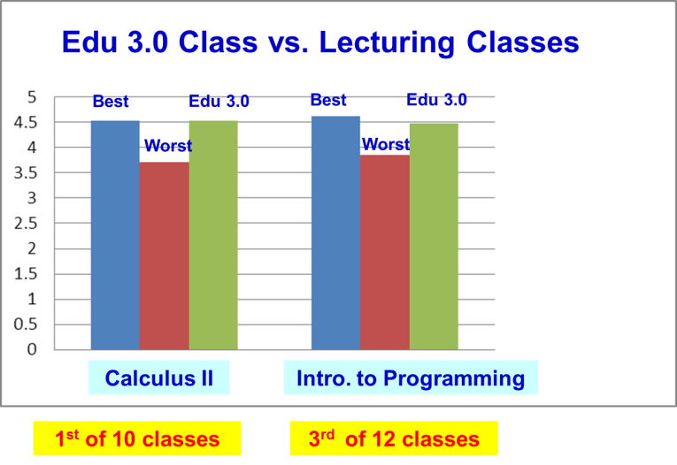
Better University Class Evaluation

Slide 36
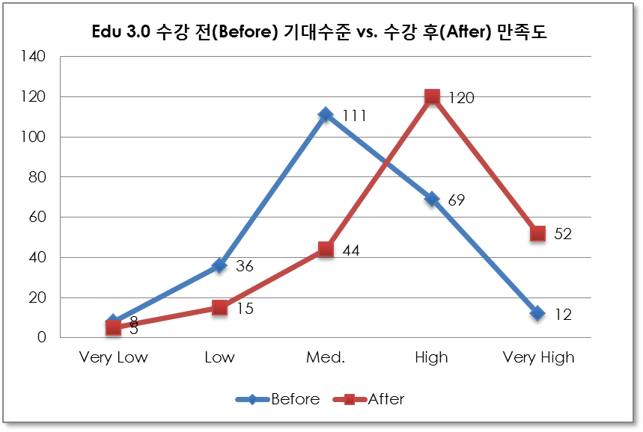
Initial Expectation vs. Final Satisfaction
Fall 2012
(N=236, Before AVE=3.1, After AVE=4.0)

Slide 37
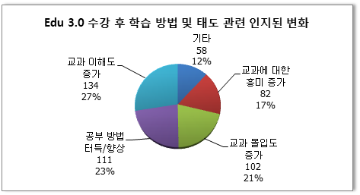
Changes in Learning Methods & Habits
71% of students reported changes
in their learning methods & habits
Others
12%
Better
Understanding
27%
Higher
Motivation & Interest
17%
Better
Learning Methods
23%
Higher
Concentration
21%
Others
better time management
learning habits
preparing for classes and discussion
collaborative learning with students

Slide 38
Professor Feedback (Fall 2013)
20 responded
75% reported better understanding by students
95% retention ratio

Slide 39
Education 3.0? - Students
Student-participative, self-learning, next generation education
Class for enjoying with TA and friends
Dynamic, energetic, interactive class
New approach for studying
Advanced educational method optimized for communication
Communication with the professor after self-study
Combination of online and offline classes
Multidimensional & multidirectional, not vertical & one-way
Smart class enabling active participation. Active communication and synergetic as compared to old, one-way, and enforcing methods
Inducing self-study. Innovation!

Slide 40
Education 3.0? - TA
과목 | Response Text
A | Make students, TA, and the professor do their own missions well
B | Students, TA, and the professor work together
C | Better task allocation between students, TA, & professor 100 times better than conventional lecturing!
E | Maximize student participation and self-study
D | Highly student-participative
F | New Approach! Likely succeed!
G | More active communication! All actively participative!

Slide 41
Professor Feedback
Succeeded in making students experiencing the process of discovering and developing ideas in bioinformatics for themselves
Students became to directly communicate with the professor and TA, and learned ways of thinking
Self-studying, independent, in-depth study, applying the learned
Proud in spite of difficulty in the first trial
Initial large time investment for making lecture videos and online quizzes. Expect to save the time by reusing them in the next class
Need to improve continuously by collaborating between lecturers and Edu 3.0 staff

Slide 42

Case 1: Introduction to Biology
Professor Experiences
Required to submit summary of lecture videos each week to promote self-study
  Easier than summarizing by reading a thick textbook
  Better understanding & reflection by summarizing in his own language
Maximize TA help
  1 TA for each group
  TAs: graduate students, + honor 3rd & 4th year undergraduates ➔ better networking, learning by teaching
Maximize group discussion for concept learning & problem solving
Each group makes a video of “biological dances” ➔ understanding and motivation
Absolute evaluation ➔ Motivation. Higher achievement

Slide 43
Case 2: Calculus I & II
Professor Experiences
Lecture videos pre-study
Extensive online exercises
  Use Pearson’s problem DB/contents
Group problem solving and discussion in class
TA roles in class
High achievement and satisfaction

Slide 44
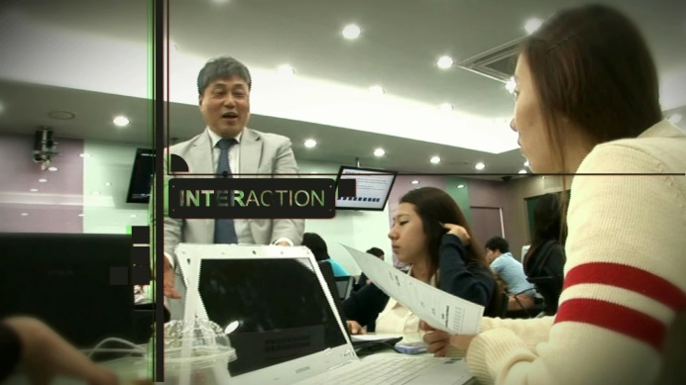
CASE 3: Introduction to Programming
Professor Experiences
Programming assignments in class for a group (2 or more)
Important
  self-study of lecture videos before class
  Culture of participation and interaction
Class activities should be closely associated with lecture videos.
Group management is important. – no free riding!
  Grouping, Periodic regrouping, Peer Reviews
Should motivate students to participate

Slide 45
Case 4: Bioinformatics
Professor Experiences
15 min Quizzes only for one of three class hours
Need a TA for each group
Q&A and group discussion in class
Productive lecture recording in a self-studio
Significantly higher level/difficult questions
  Past: questions on simple concepts
  Now: More advanced questions

Slide 46


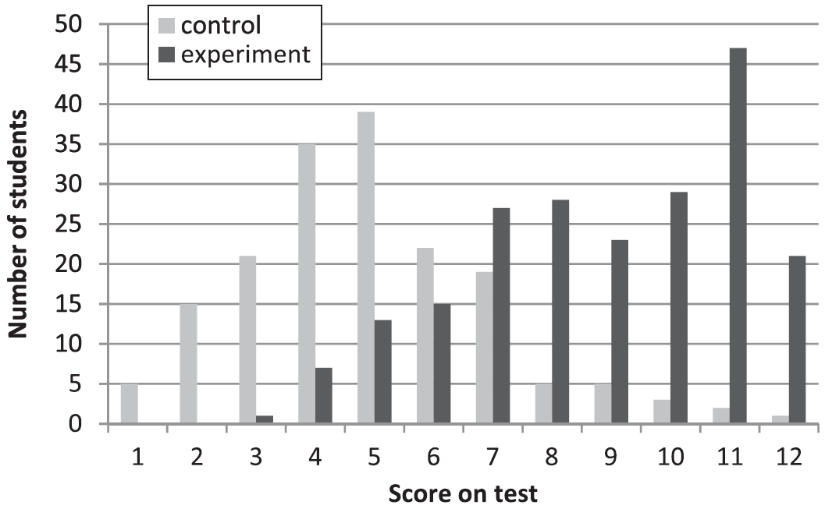
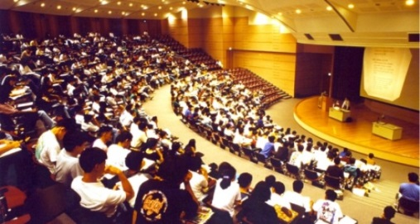
Do you need more Scientific Evidences?
L. Deslauriers, E. Schellew, and C. Wieman, “Improved Learning in a Large-Enrollment Physics Class”, Science Vol. 332, May 2011
Group 1: Keep on Lecturing by Professor
Group 2: Interactive Class without Lecturing,
Postdoc for Coordination
Basic Physics – Large Class ( > 300 students), Conventional Lecture Hall, For 11th week, divide the class into two groups. Take the same exams of 12 problems

Slide 47
Sustainable!
Even Better!
Just Begun!

Slide 48
Neither for better
Exam scores
Nor for better
class evaluation
Then, for what?

Slide 49
INTERACTION
Learning
Creative
Synthesizing
Communication, Teamwork, Leadership
Neuroscience, Brain Research, Cognitive Psychology
Concentration
Long-Term Memory
Structuring
Knowledge
Active
Friendship
Character

Slide 50
Innovation in
Knowledge-Based Society & Industry Needs
Creative
Synthesizing
Communication, Teamwork, Leadership

Slide 51
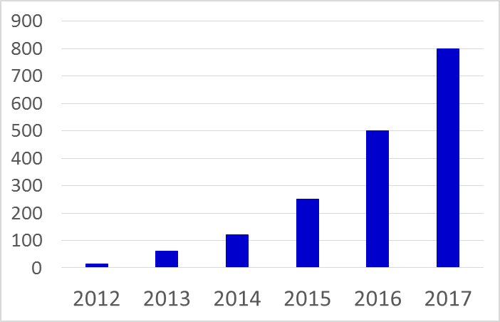
2017 (5 Years) Vision
University Long-Term Plan
Government Funding
Donation: $9 million
30% of Classes (800) ➔ Edu 3.0
60 Education 3.0 (Interactive) Classrooms
Training New & Promoted Faculty
Space
- Most Critical

Slide 52
e-KAIST
Contribute
to Society
Transform
Education
Connect
Global e-Learning +
Classroom Networking
Transform
Open
Education 3.0
Interactive Class
MOOC
Coursera
KOOC
- KAIST MOOC

Slide 53
Thank you!
53

