Slide 1
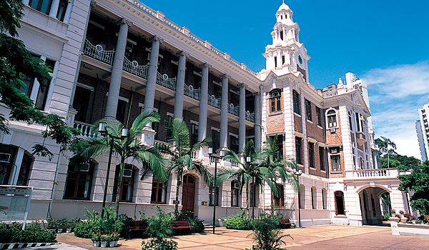
The Centre for the Enhancement of
Teaching and Learning (CETL)
From Teaching and Learning Strategy to Quality Enhancement
Professor Grahame Bilbow
Director, Centre for the Enhancement of Teaching and Learning
The University of Hong Kong

Slide 2
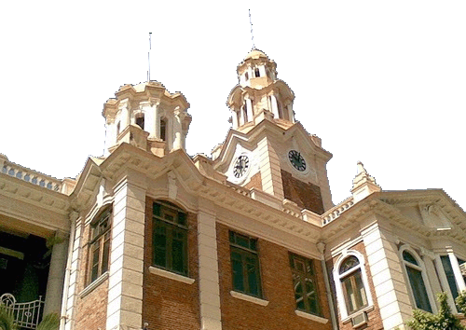
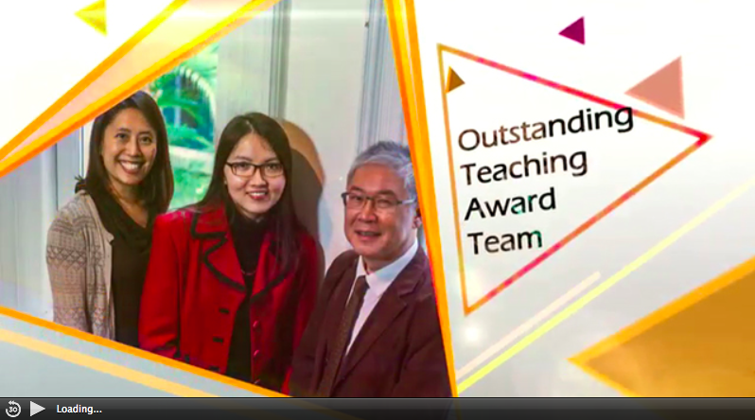
Outstanding Teaching Award (Team) Winners 2013

Slide 3

Traditional Higher Education
Few
Flexible
pathways
Narrow,
Specialised
Academic
Programmes
Examinations
requiring
book-based
revision
Traditional
emphasis on
lectures and
book-based
learning

Slide 4
The Changing World of Higher Education
What exactly is the purpose of a university education?
How can we ensure that a university education is worthwhile and relevant?
How should universities facilitate student learning?
How should universities measure students’ learning?

Slide 5
The University of Hong Kong

Slide 6
HKU: Past and Present
1st University in Hong Kong, established in 1912, serving the needs of local Chinese students.
Started with Arts, Engineering and Medicine; now ten Faculties (Arts, Science, Engineering, Architecture, Medicine, Dentistry, Law, Social Sciences, Business and Economics, and Education) + Centres, etc.
Initially intended to educate young Hong Kong Chinese students; now highly internationalised (50% non-local students from mainland China and elsewhere, and many international staff)
Highly ranked (1st in Hong Kong, 1st in Greater China, 2nd in Asia, and 26th in the world).

Slide 7
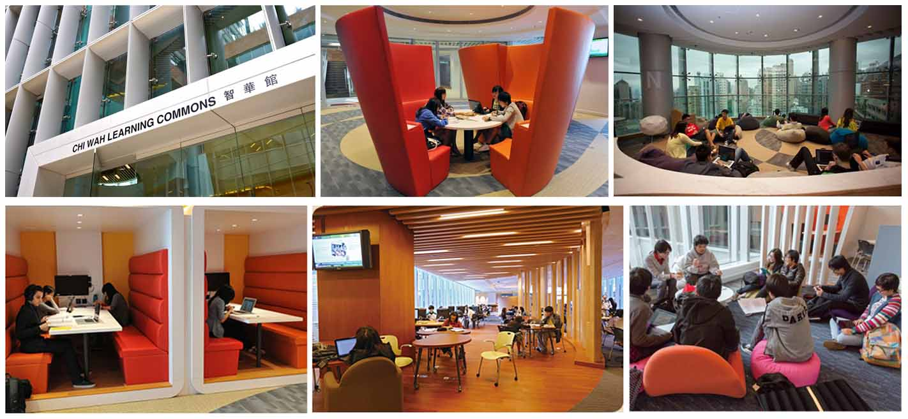

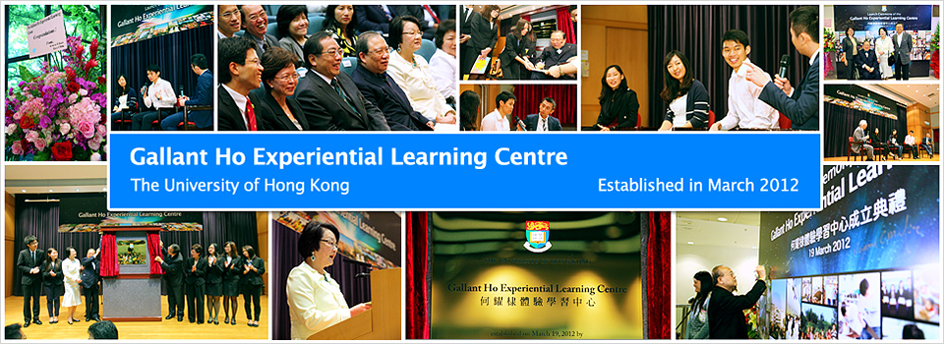
HKU: Teaching and Learning Environment
Creative Use
of Space
Flexible Learning
Experiential
Learning

Slide 8
HKU: The Changing Curriculum
Outcome Based Approach to Student Learning (OBASL)
“clearly focusing and organizing everything in an educational system around what is essential for all students to be able to do successfully at the end of their learning experiences” (Spady, 1994, p.12)
Ensuring that what is taught, learnt and assessed on courses and programmes dovetails directly and explicitly with the University’s broad educational aims.
Ensuring that the University’s educational aims are demonstrably achieved through every individual student’s learning experiences.

Slide 9
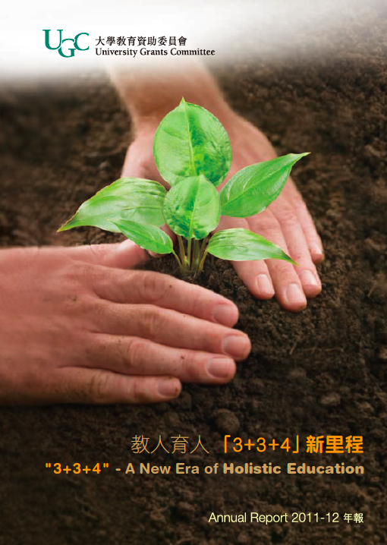
HKU: The Changing Curriculum
The Four Year Curriculum
The Hong Kong Government announced in 2004 that from 2012, undergraduate education should typically be of four years’ duration - ‘3+3+4’ reform.
HKU Educational Aims:
Pursuit of academic/professional excellence, critical intellectual enquiry and life-long learning
Tackling novel situations and ill-defined problems
Critical self-reflection, greater understanding of others, and upholding personal and professional ethics
Intercultural understanding and global citizenship
Communication and collaboration
Leadership and advocacy for the improvement of the human condition

Slide 10
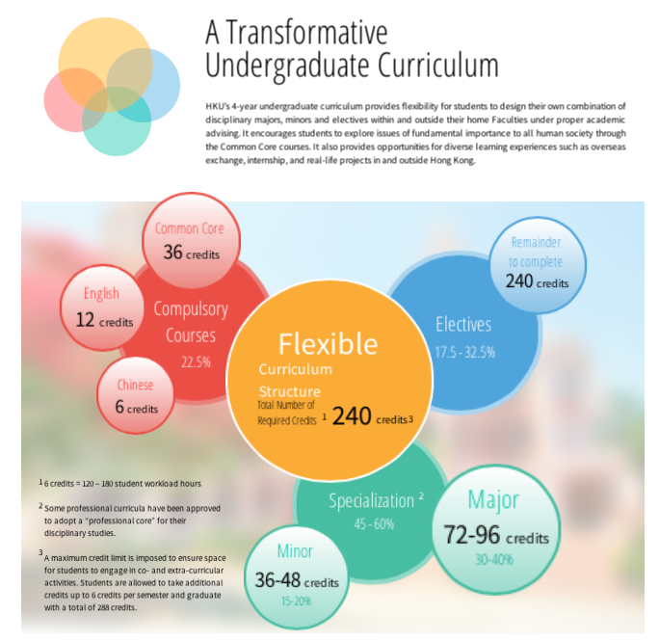
HKU: The Changing Curriculum
Course Learning Outcomes, Programme Learning Outcomes and University Educational Aims
Programme maps shared with teachers and students.
The Common Core Programme: exploring issues of significance to humankind from an interdisciplinary perspective

Slide 11
HKU: Teaching and Learning Strategy
Supports evidence-informed teaching and learning and teaching excellence. Funding allocated to:
The creation and sharing of scholarship of teaching and learning in areas such as eLearning, curriculum design, pedagogy, assessment for learning;
The international sharing of pedagogic expertise through exchange with the UK, Australia, China and so on;
The recognition of teaching excellence through a Teaching Excellence Award Scheme.

Slide 12
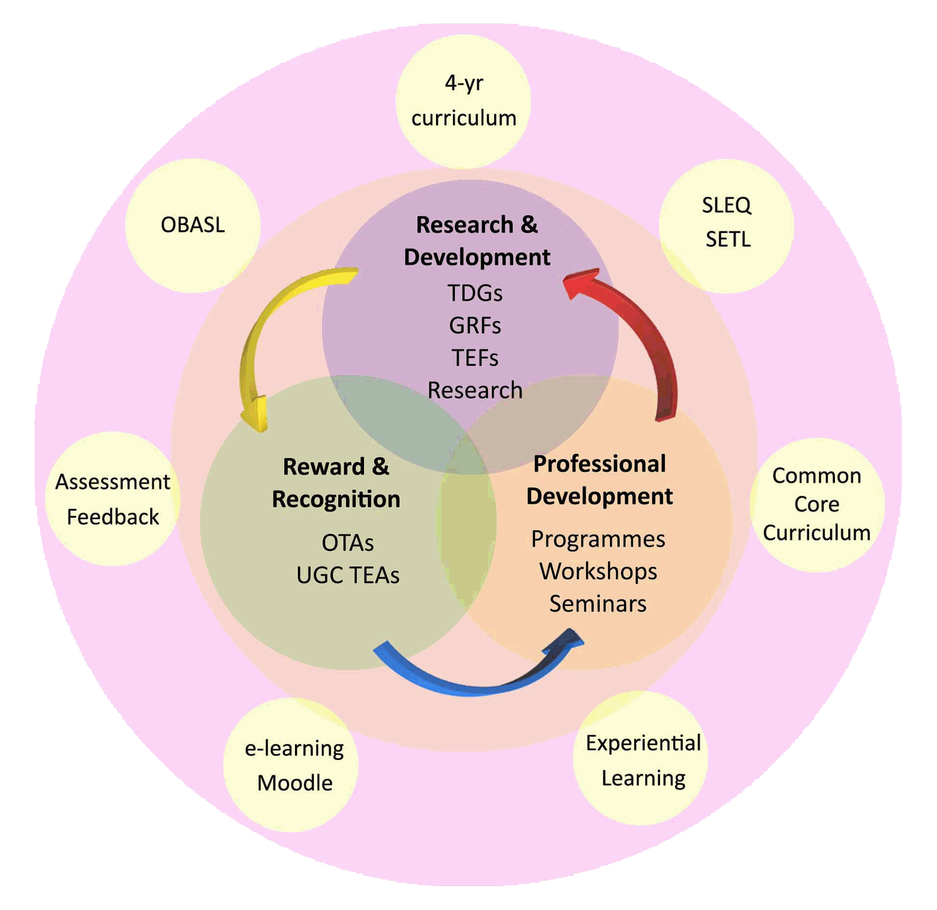
The Centre for the Enhancement of Teaching and Learning (CETL)
Quality Enhancement NOT Quality Assurance
Research and scholarship, professional development and reward and recognition.

Slide 13
CETL: Research and Development
9m HK$ annual budget for teaching development projects.
Currently 10m HK$ allocated to 39 projects in areas such as assessment tasks and assessment standards, eLearning and integration with Moodle LMS, experiential learning, and so on.
Funding to encourage international exchange and the sharing of pedagogic expertise.

Slide 14
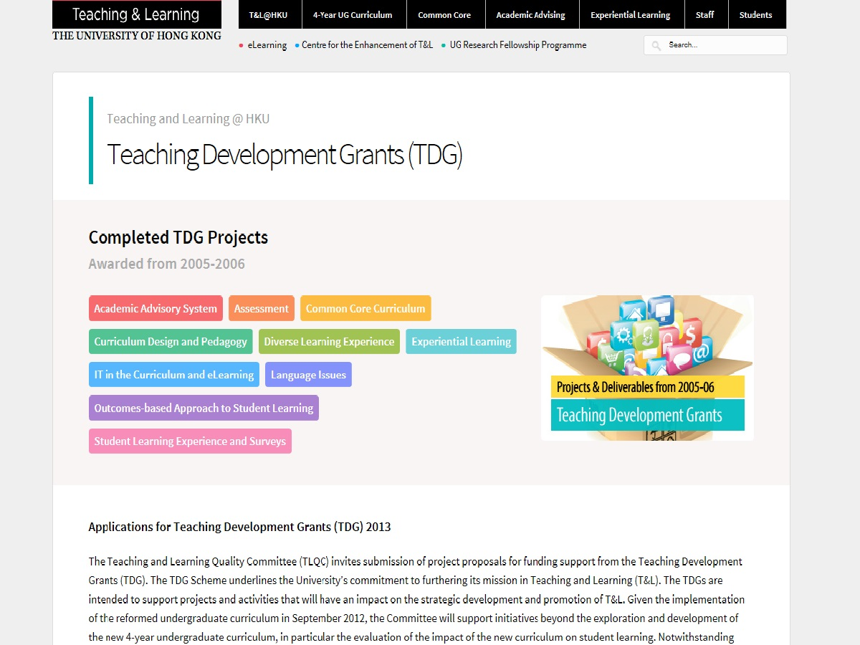
Teaching Development Grant Website

Slide 15
CETL: Professional Development
Introduction to Teaching and Learning @ HKU programme for new staff at HKU.
Advanced Teaching and Learning @ HKU programme for staff new to university teaching.
Certificate of Teaching and Learning in Higher Education programme for RPg students with teaching and assessment duties.
Regular programme of lunchtime workshops. On average 40 per year.

Slide 16
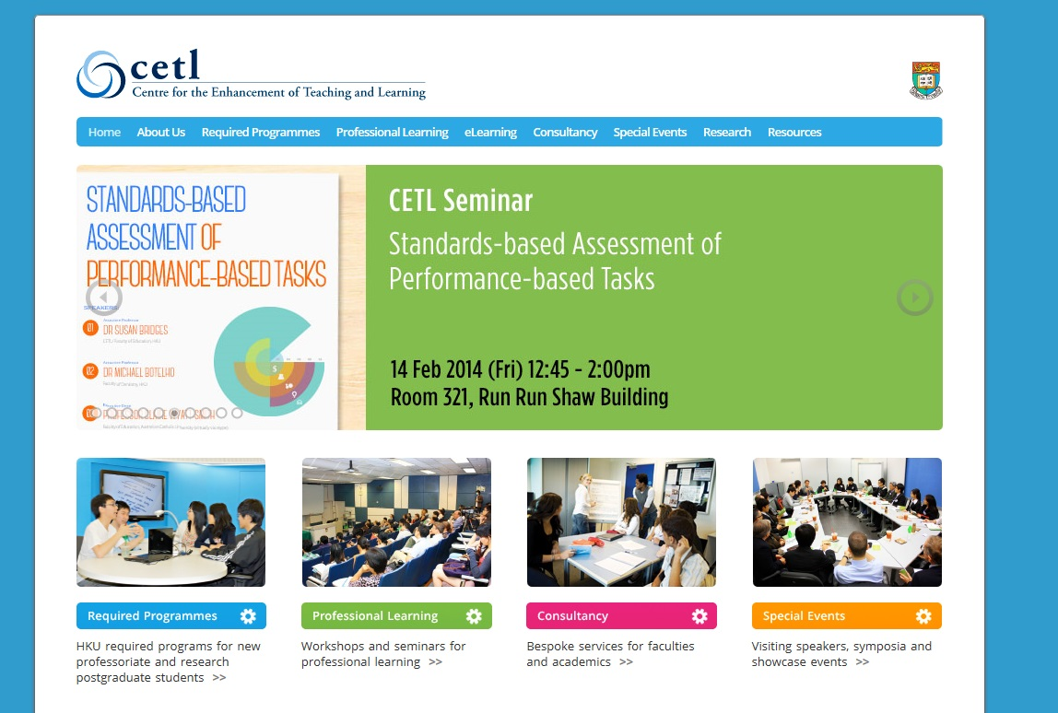
CETL: Seminars

Slide 17

CETL: Reward and Recognition
Outstanding Teaching Awards.
Outstanding Teaching (Team) Awards.
University Distinguished Teaching Awards.

Slide 18
Thank You!

