Slide 1
Activities of Teaching Learning Support Center, Osaka University
Haruo Takemura
Director, TLSC
Osaka University

Slide 2
Who am I?
Name: Haruo Takemura
  Computer Science, Human Computer Interaction,
  Virtual Reality, Augmented Reality, e-Learning Systems etc.
Professor, Informedia Education Research Division, Cybermedia Center, Osaka University
Professor, Graduate School of Information Science and Technology, Osaka University
Head, Division for Planning and Development, Center for Education in Liberal arts and Sciences
Director, Teaching and Learning Support Center, Osaka University
Vice Head, Creative Unit, Osaka University

Slide 3
Who am I (2)
President, Japan OpenCourseWare Consortium
Board member, Open Education Consortium
Vice President, Virtual Reality Society of Japan
Board member, Human Interface Society.
Member at IEEE, ACM, IPSC, IEICE etc.

Slide 4
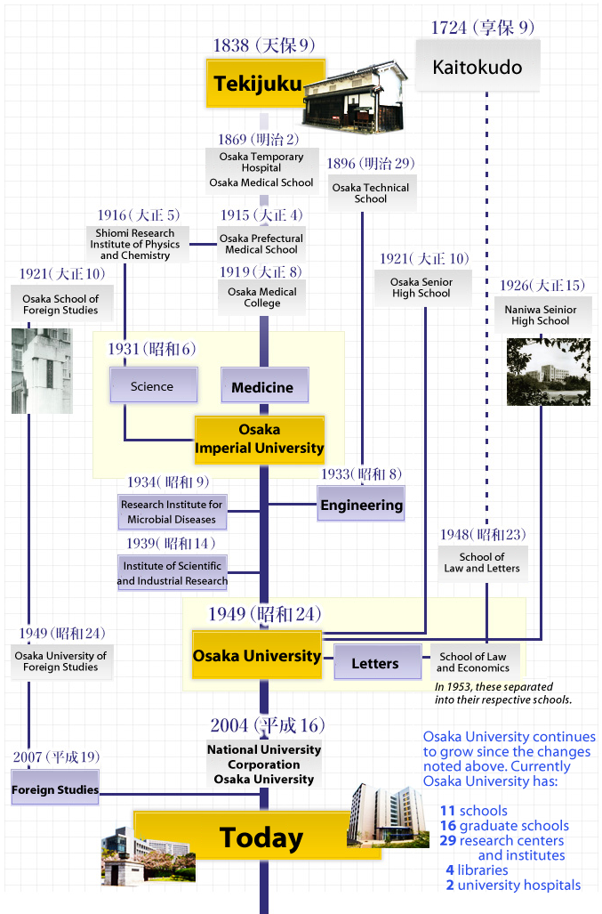
History of Osaka University(1)
Established in 1931.
Its root goes back to 1838.

Slide 5
History of Osaka University(2)
25,000 Students
3,000 faculty
Research Oriented University
Ranked as No. 3 in Japan

Slide 6
Teaching and Learning Support Center
6 year project from 2013 to 2019
Introducing active learning to create positive spiral of learning
Establish One-stop-service for campus wide faculty development
IT is used to maximize outcome with small number of staffs
↓
Using e-Learning and active learning methods for FD, preFD, RD
We have introduced three systems that is designed to support spontaneous and active learning FY2013

Slide 7
Enhancing Education with establishment of TLSC
大阪大学のルーツ
① Teaching support
In Class Learning
Enriched
Education
Learning Spiral beyond Class boundary
Teaching and Learning Support Center （TLSC）
Active Learning
Honor Program
e Learning
e Portfolio
Graduate Level
General Education
Schools
Sub Major, Sub Program
Professional
Education
Sufficient hours with spontaneous Learning
Learn
CELAS
General
Education
Spiral
For
Quality
Assurance
Off Class Learning
ＴＡ
自主研究
「Desire to Learn」
Motivation
「Learned」
Joy of Learning
FD Workshop
Science
workshop
Career Development
Workshop
Problem solving
internship
② Out of class learning support
（キャリア開発機能の強化）
※：Grey letter indicates project with
other funding source

Slide 8
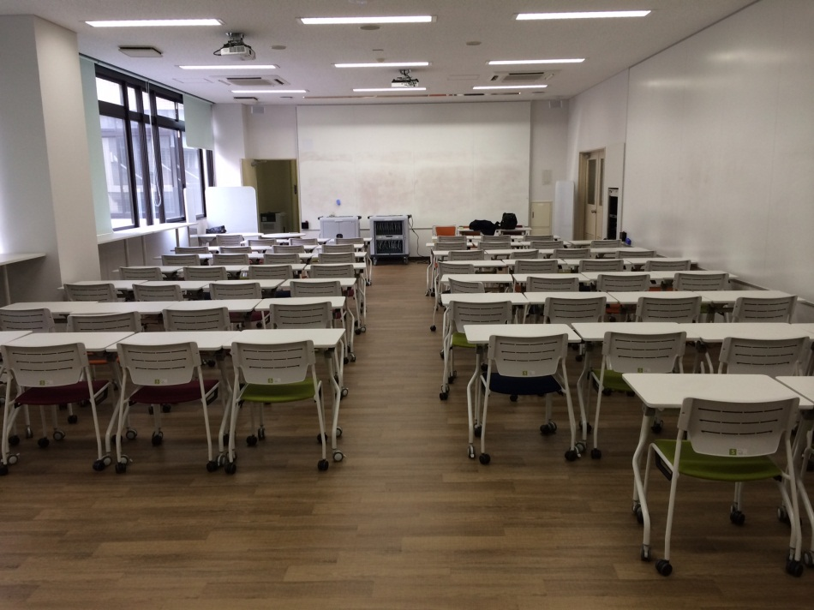
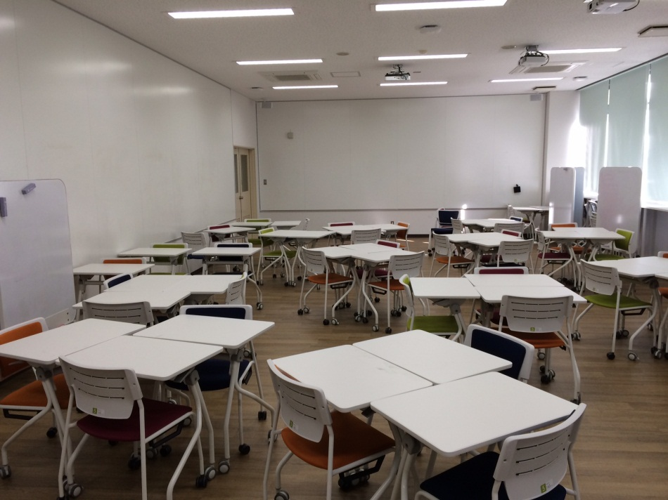
ICT supported collaborative learning classrooms
Room A212 and A312 in CELAS building were renovated as ICT supported collaborative learning classrooms. This rooms support both lecture type education and collaborative group work education. Setting changes can be easily done during class hours.
The room support spontaneous learning of students in usual classes.
Lecture setting
Collaborative learning setting
Easy
Setting
change
Rooms consist of,
・movable chairs, desks and white boards which support variety of group layout。
・Walls are made of white board which can also be used for projection screen.
・four projectors with matrix switches with apple TV devices. This enables a lecturer’s or student’s iPad Screen can be projected easily.
・iPad tablet for students to use with various teaching and learning support applications

Slide 9

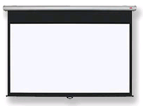









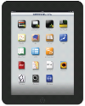






Class room response system with mobile device support
The system which works like clickers by using smart phone and other mobile devices in lecture rooms in CELAS building.
Lecture Rooms in CELAS
ICT supported collaborative learning classrooms
Projector
WiFi
ＰＣ
WiFi or 3G, 4G LTE
Instructor’s iPad
Real Time
Response sys.
Instructor’s iPad
協働学習支援機能
・リアルタイム応答
・イメージボード
・テキストボード
・URL配信
・ファイル共有 等々
Students’
iPad
Students use their own devices
iPad equiped for the room
・・・
Instructor
Cybermedia Center
Students
Questions
Enrollment Info
Response to Question
Response Info
BeeDance Server
Blackboard LMS)

Slide 10

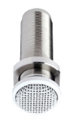

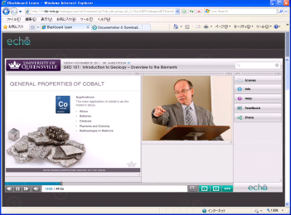
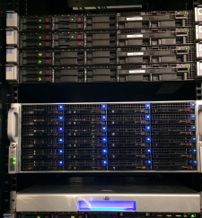
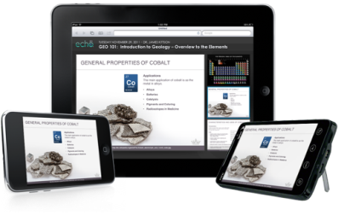
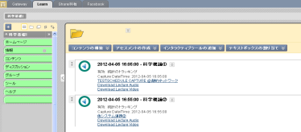
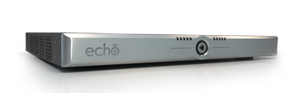
Automated Lecture Capture system (Echo360）
Lectures are automatically recorded based on pre-registered lecture schedule. PC output, blackboard image, and instructor’s voce are recorded. The contents are provided thorough LMS(blackboard R.9.1) to students who is registered for the lecture only.
Scheduled recording
Archiving
Delivery
Automated
Postproduction
and Archiving
PC
Screen
Microphone
HD Camera
EchoSystem
Server
Auto-
mated
linkage
Learning Contnets
Links are
generated
EchoSystem capture appliance
Blackboard LMS
Support various devices
12 lecture rooms are equipped with
This system
Campus License for authoring
Software is also provided.
Servers are place at
Cybermedia Center Bldg.
Sutdnets can view lectures
With PC（Web browser）、
iPhone、iPad or Android .

Slide 11
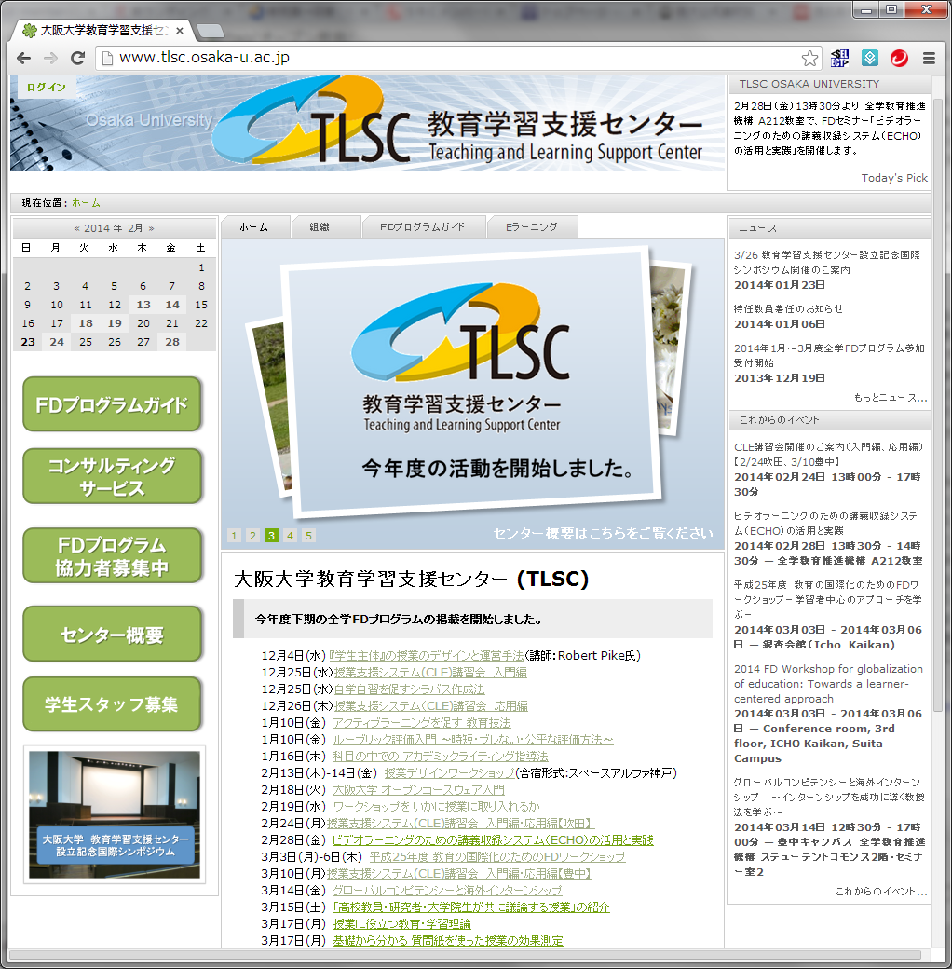

Slide 12
Researcher Development at Osaka University.
TLSC Transferable Skills Workshop
2014 / 03/ 24
Morning Workshop in Japanese
Instructor Dr Yamanouchi, Mr. Mori and Dr. Hori（Osaka Univ.
Self introduction Skills,
Skills for better communication,
Group work for organizing given information
Afternoon Workshop in English
Instructor Dr. Jon Turner (Univ. of Edinburgh)
Attitude as an expert. Project management skills
Intensive training for communication
参加者 午前８名、午後１２名

Slide 14
Pre-Faculty Development at OU
④未来の大学教員養成プログラム
（Future Faculty Program）
90hours（2 credit unit）→360hours（8credit unit) from 2015
▶provided as inter graduate school lecture
From 2014[University Course Design Ⅰ」（90hours：2CU）is being taught for 20 students.
From 2015, three other courses are provided in order to make 360 hours (8CU) program that can be treated as sub program for graduate study. Teaching experience and project management are planned to be taught.
Those who finished this sub program will get a certificate that is necessary for applying STA(Senior teaching assistant), TF(Teaching fellow) or LA(Learning advisor).

Slide 15
Teaching Assistant system at OU
Teaching Fellow system (a qualification for students allowing to teach whole course) is also planned.
Name | Role | qualificatoin
STA | Class assistant including partial course design and teaching with instructor’s supervision and managing JTAs | Ph.D candidates only（needs STA qualification）
JTA | Class assistant with instructor’s supervision | Graduate students
SA | Assistant without instructions | Undergraduate studentss

Slide 16
Summary
Over view to TLSC at Osaka University
ICT systems which support active learning concept.
Overview of FD program by TLSC
Overview of Researcher development and pre FD.

